Slide 1
Ransomware Extortion in Healthcare
“An evidence-based analysis of the HSE (2021) and Change Healthcare (2024) incidents”
Name: Khalid Bakhshi
PICT3011 Cyber Security in Practice
Notes:
This presentation examines ransomware extortion in healthcare through two incidents:
The 2021 Conti attack on Ireland’s Health Service Executive, or HSE,
and the 2024 ALPHV BlackCat attack on Change Healthcare in the United States.
My objective is to develop an initial evidence-based attack model,
identify the weaknesses that may have enabled these incidents,
and recommend the areas healthcare organisations should address first.

Slide 2
Investigation Scope and Preliminary Finding
Investigation Scope | Scope and preliminary finding
Attack category | Ransomware extortion affecting healthcare organisations
Incidents examined | HSE, Ireland, 2021: Conti ransomware Change Healthcare, United States, 2024: ALPHV/BlackCat ransomware
Evidence base | Official incident reports, congressional testimony, government guidance and organizational disclosures
Analytical approach | Manual and one-shot LLM attack trees were compared and synthesized for each incident before developing a cross incident model
Preliminary finding | Different initial access routes converged on enterprise expansion, encryption, data theft and extortion
Key finding | Several mechanisms remain unknown or redacted, so the attack tree represents a preliminary model
Investigation question: Which recurring attack pathways and control weaknesses should healthcare organisations address first?
Sources: PwC (2021, pp. 29, 45, 54–55); Witty (2024, pp. 2–3); Fliegelman and Stemp (2024, pp. 1–6).
Notes:
I chose these cases because they involved the same sector and attack category, but had different initial-access routes.
HSE began with a malicious Excel attachment. Change Healthcare began with compromised credentials used against a Citrix remote-access portal without multi-factor authentication.
Despite that difference, both incidents developed into enterprise expansion, data theft, encryption and extortion.
The attackers entered through different doors, but followed a broadly similar path once inside.
(PwC, 2021, p. 45; Witty, 2024, p. 3)

Slide 3
Healthcare Ransomware Extortion
Ransomware extortion: involves attackers encrypting systems, stealing sensitive data, or using both methods to pressure an organisation into pay a ransom.
Extortion pathway | Attacker actions | Potential business impact
Availability pressure | Deploy ransomware and encrypt systems | Services become unavailable, disrupting care, claims, pharmacy services and payments
Confidentiality pressure | Locate, copy, and exfiltrate sensitive data, then threaten disclosure | Privacy harm, breach notification obligations, reputational damage and additional extortion pressure
Critical assets: patient information, clinical and administrative systems, claims and payment platforms, privileged accounts, backup infrastructure and dependent healthcare services
Both investigation incidents involved encryption and stolen data pressure, representing double extortion.
Sources: NIST (2026); PwC (2021, pp. 1, 45, 54–55); Witty (2024, pp. 2–3); UnitedHealth Group (2024).
Notes:
In this investigation, ransomware extortion means a human-operated attack that creates payment pressure through system disruption, stolen data, or both.
Healthcare organisations are particularly exposed because unavailable systems can interfere with clinical services, medication, claims and payments.
Data theft can also expose protected health and identity information.
The critical assets therefore include identity infrastructure, clinical and administrative applications, sensitive data, backups, claims platforms, and the organisation’s ability to continue delivering care.
(PwC, 2021, pp. 45–46; Fliegelman and Stemp, 2024, pp. 2–6)

Slide 4
Investigation and Evidence Method
Stage | What I did | Purpose
1. Evidence audit | Extracted attacker actions, affected assets, control weaknesses and evidentiary gaps from each source | Separated confirmed evidence from assumptions and threat-intelligence hypotheses
2. Manual modelling | Independently constructed an attack tree for each incident using explicit AND and OR gates | Produced an evidence-based model before viewing the LLM result
3. LLM generation | Used one prompt with ChatGPT for each incident and retained the original output | Created an independent LLM model for comparison
4. Comparison and synthesis | Compared the manual and LLM trees, removed unsupported paths and incorporated useful differences | Produced a case-synthesised tree for each incident and a final cross-incident model
Evidence Status Legend
Status | Meaning | Colour
R-H | Reported evidence, high confidence | Green
I-M | Evidence based inference, medium confidence | Amber
U | Unknown or redacted | Red
Only attacker actions appear inside the tree. Control weaknesses appear as side annotations, and undisclosed mechanisms remain marked as unknown
Notes:
The main HSE source was PwC’s independent post-incident review.
For Change Healthcare, I used Andrew Witty’s congressional testimony,
UnitedHealth disclosures, the Office of Financial Research brief,
and government guidance.
I labelled reported evidence as R-H, evidence-based inference as I-M, and unknown or redacted mechanisms as U.
I manually built each tree using attacker actions only, with control weaknesses shown separately.
I then generated one uncorrected ChatGPT tree for each incident, compared the outputs,
and created case-level and final cross-incident syntheses.
(PwC, 2021; Witty, 2024; UnitedHealth Group, 2024; Fliegelman and Stemp, 2024; CISA, FBI and HHS, 2024)

Slide 5
HSE Conti Ransomware Incident, 2021
Attack Stage | Publicly reported evidence | Status
Initial access PwC (2021, pp. 29, 45) | Attackers sent a phishing email containing a malicious excel attachment and established a foothold on the patient-zero workstation | R-H
Enterprise expansion PwC (2021, pp. 29, 45, 54) | Attacker conducted Active Directory reconnaissance, compromise at least 33 privileged accounts and moved through connected HSE and hospital environments | R-H
Coercive impact PwC (2021, pp. 29, 45, 55) | Attackers deployed Conti across the HSE and six hospitals. Encryption affected more than 2800 servers and 3500 workstations | R-H
Data and extortion PwC (2021, pp. 1, 54–55) | Attackers accessed and copied files, published authentic samples and demanded payment for decryption and non publication | R-H / I-M
Critical assets: clinical and administrative systems, patient and organizational data, Active Directory, privileged accounts servers, workstations and backup infrastructure.
Business impact: widespread healthcare-service disruption, loss of system availability, recovery costs and potential privacy harm.
EVIDENCE GAPS:
U: Exact persistence mechanism was not disclosed
U: The vulnerability exploited at Hospitals A and B was redacted
I-M/U: Investigators could not conclusively establish the complete data-exfiltration route or volume
Source: PwC (2021, pp. 1, 29, 45, 54–55).
Notes:
PwC reported that the phishing email arrived on 16 March 2021, and the patient-zero workstation became infected on 18 March.
The attacker remained in the environment until Conti ransomware was executed on 14 May. This provided almost two months for reconnaissance, privilege acquisition, and lateral movement.
Investigators found evidence of encryption on more than 2,800 servers and 3,500 workstations.
HSE management estimated that around 80 per cent of the environment was encrypted.
Email, Active Directory information and file data were also exposed.
Important technical details, including the persistence method and the name of one exploited vulnerability, remain undisclosed.
(PwC, 2021, pp. 29, 45–46)

Slide 6
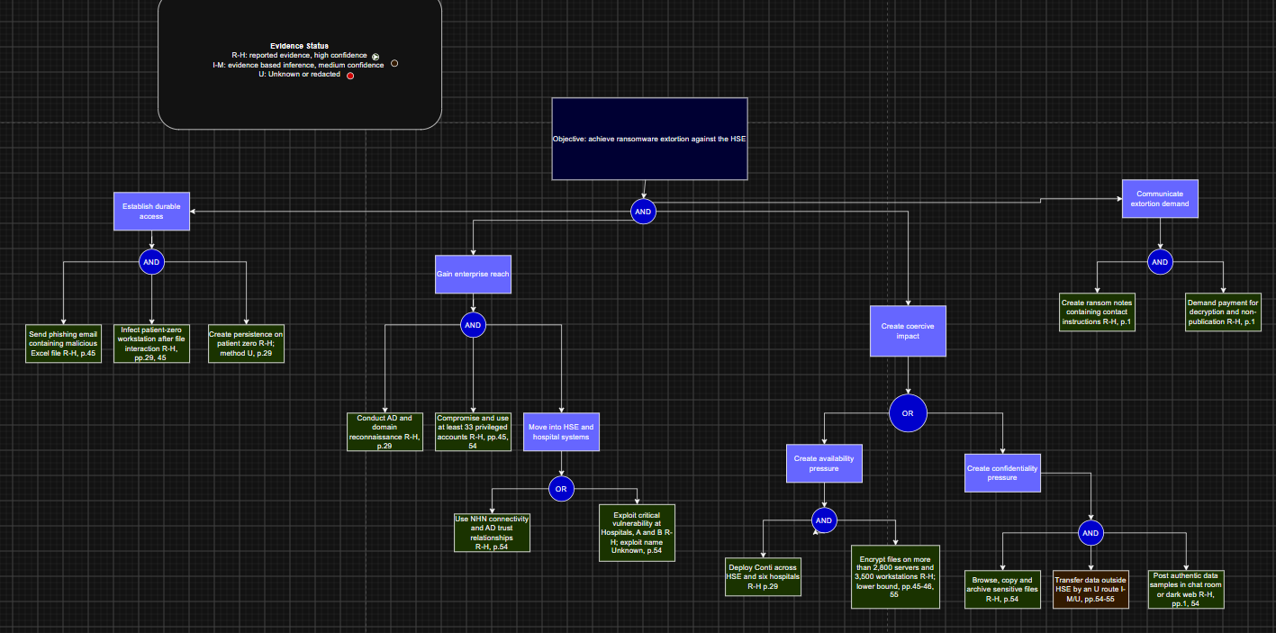
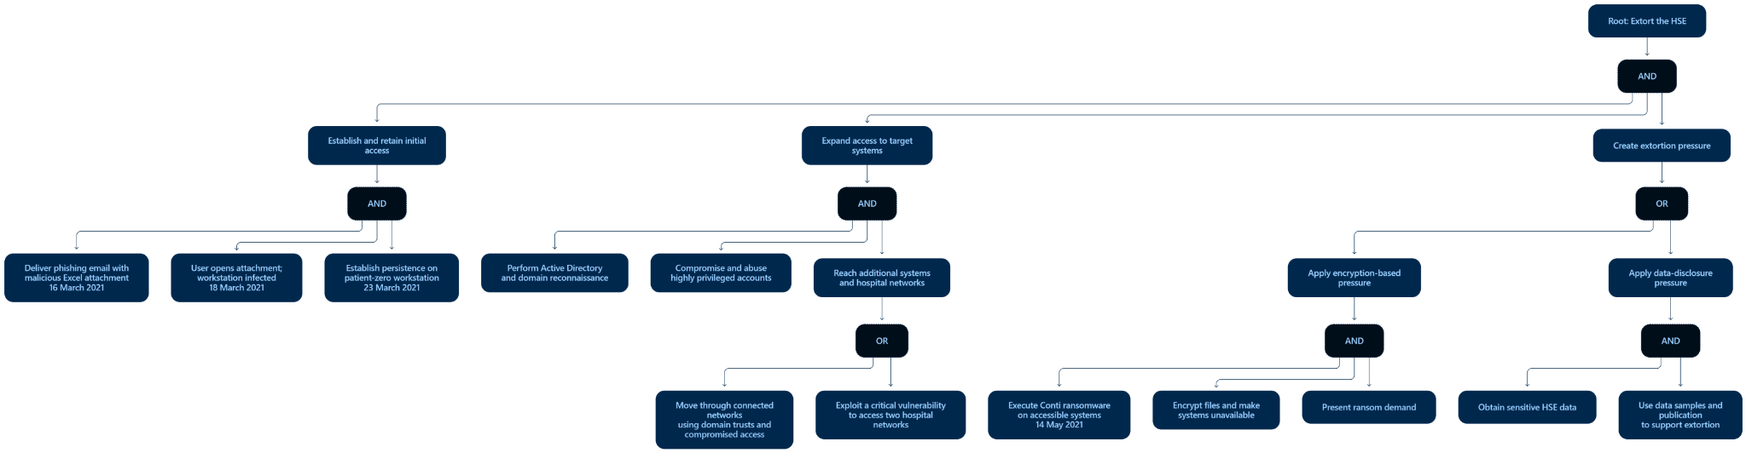
HSE Manual and LLM Attack Trees
Manual attack tree
Original ChatGPT attack tree
Full models are provided in Appendices A and B.
Notes:
The HSE tree’s root objective is to achieve ransomware extortion. Its AND gate requires durable access,
enterprise reach, coercive impact, and communication of the demand.
The access branch covers delivery of the malicious attachment, infection of patient zero,
and persistence.
Persistence is marked unknown because PwC did not disclose its mechanism.
Enterprise reach required reconnaissance and privileged access.
The attacker then moved through network connectivity and Active Directory trusts, or through a critical vulnerability affecting two hospitals.
The exploit name is also marked unknown.
Finally, encryption created availability pressure, while stolen data created confidentiality pressure.
The side annotations show contributing weaknesses, including monitoring-mode antivirus, weak alert escalation, privileged-account weaknesses, limited segmentation, and vulnerable backups.
(PwC, 2021, pp. 29, 37, 45, 47–55)

Slide 7
HSE Manual and LLM Attack Tree Comparison
Comparison area | Manual attack tree | ChatGPT Tree
Overall structure | Separates access, enterprise reach, coercive impact and communication of the demand | Captures access, expansion and extortion pressure but places the ransom demand under encryption
Evidence Handling | Provides report pages and evidence status beside the leaves | Provides a concise pathway but lacks consistent page references and evidence statuses
Attacker actions | Contains only actions performed by the attacker | Includes “user opens attachment” which describes a victim action
Uncertainty | Marks persistence, the hospital exploit and exfiltration details unknown or inferred | Does not clearly display these evidence gaps
Main strength | Detailed, traceable and supported by the PwC report | Simple structure that clearly presents encryption and stolen data pressure
Main limitation | More complex and visually dense | Oversimplifies the evidence and presents some uncertain mechanisms too confidently
Synthesis decision: Retained the LLM tree’s clear distinction between encryption and stolen data pressure, while applying the manual tree’s evidence citations, attacker action rule and uncertainty.
Source: Comparison of the HSE manual tree and the original ChatGPT Astra output. Full models and the LLM prompt are provided in Appendices A and B.
Notes:
ChatGPT produced a structured diagram.
It represented encryption and data disclosure as sources of leverage, and avoided inventing the redacted vulnerability.
However, it placed “user opens attachment” inside the tree, even though that is a victim action.
It also omitted page-level evidence labels, control-weakness annotations, and a clear unknown marker for persistence.
The case synthesis kept the LLM’s readable structure, but corrected those issues using the manual evidence audit.
This shows where an LLM can help organise information, but still requires human validation.
(OpenAI, 2026; PwC, 2021)

Slide 8
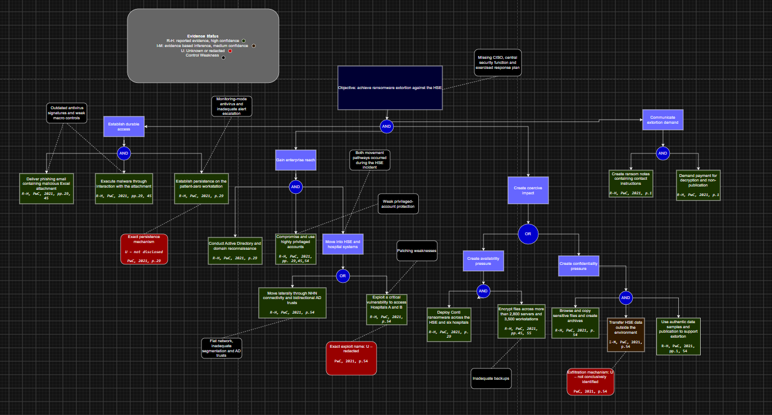
HSE Case Synthesised Attack Tree
Simplified presentation view — full model provided in Appendix C.
Notes:
The synthesised HSE model separates attacker actions from the conditions that enabled them.
For example, weak macro controls appear beside initial access, rather than inside the attack path.
It also preserves redacted mechanisms as unknown, instead of filling evidence gaps with plausible but unsupported techniques.
(PwC, 2021, pp. 29, 45–55; OpenAI, 2026)

Slide 9
HSE Case Synthesised Attack Tree Analysis
Key interpretation
The root uses AND because the attacker required access, enterprise reach, coercive impact and communication of the demand.
The impact branch uses OR because encryption or stolen-data disclosure could create extortion pressure. Evidence indicates that both occurred.
Unknown persistence, vulnerability and exfiltration mechanisms remain marked U rather than assumed.
Key finding
Multiple weaknesses in prevention, detection, privileged access, network segmentation and recovery contributed to the incident
Source: Synthesis based on PwC (2021, pp. 1, 29, 37, 45, 47–55). Full-size model in Appendix C.
Notes:
[Talk key finding]
Multiple weaknesses in prevention, detection, privileged access, network segmentation and recovery contributed to the incident.

Slide 10
Change Healthcare Ransomware Incident, 2024
Stage | Publicly reported evidence | Status
Initial access | On 12 February 2024, attackers used compromised credentials to access a Citrix portal that lacked MFA | R-H
Enterprise expansion | The attackers move laterally and exfiltrated data before deploying ransomware. The detailed mechanisms remain undisclosed. | R-H / U
Coercive impact | On 21 Feburary, the attackers deployed ransomware. Stolen personal and health information provided additional disclosure pressure. | R-H
Extortion and response | UnitedHealth Group confirmed that it paid the ransom. Change Healthcare disconnected affected systems to contain the attack. | R-H
Notes:
Andrew Witty testified that attackers used compromised credentials to access a Change Healthcare Citrix portal on 12 February 2024.
The portal did not have MFA.
The attackers moved laterally, exfiltrated data, and deployed ransomware nine days later.
UnitedHealth confirmed that affected files contained protected health information and personally identifiable information.
Change Healthcare’s role made the impact systemic.
Its services connected healthcare providers, pharmacies, insurers, claims, and payments.
When Change went offline, providers experienced operational disruption and serious cash-flow pressure.
The credential source and detailed internal techniques remain unknown.
(Witty, 2024, pp. 2–4; UnitedHealth Group, 2024; Fliegelman and Stemp, 2024, pp. 2–6)

Slide 11
Change Healthcare Ransomware Incident, 2024
Assets and Consequences
Critical assets | Business consequences | Evidence gaps
Claims processing and payment services | Nationwide disruption to healthcare payment workflows | Credential acquisition method: U
Pharmacy transaction services | Cash flow pressure on healthcare providers | Lateral movement tools and techniques: U
Healthcare data exchange systems | Loss of system availability | Detailed data-exfiltration route: U
Personal and protected health information | Privacy, notification and regulatory exposure
Preliminary finding: There was no MFA, which allowed the attacker to use the compromised credentials to gain remote access
Sources: Witty (2024, pp. 2–3); Fliegelman and Stemp (2024, pp. 1–6); UnitedHealth Group (2024); HHS (2025).
Notes:
[Talk Preliminary Finding]
There was no MFA, which allowed the attacker to use the compromised credentials to gain remote access

Slide 12
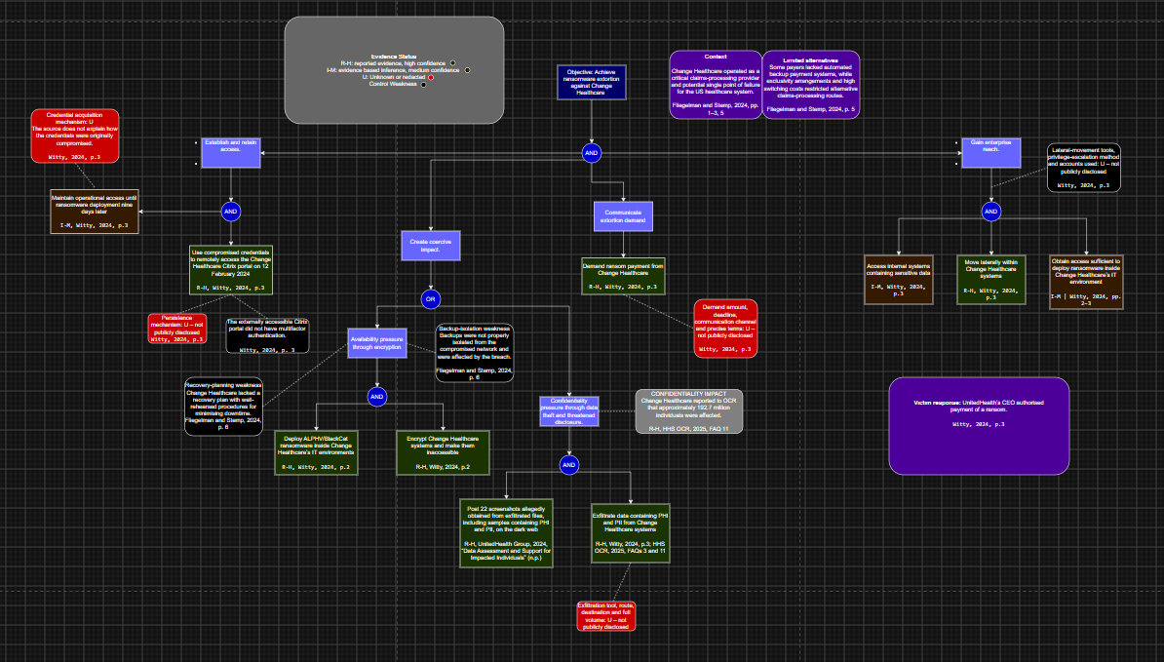
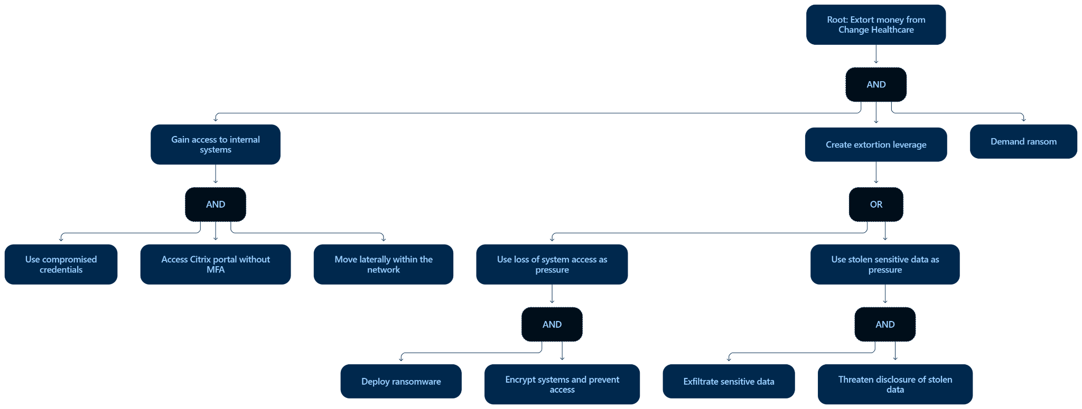
Change Healthcare Manual and LLM Tree Comparison
Original ChatGPT attack tree
Manual attack tree
Simplified presentation view — full models provided in Appendix D and E
Notes:
The manual tree begins with using compromised credentials to authenticate to the Citrix portal.
Missing MFA is shown as a control weakness, rather than an attacker action.
I did not add phishing or malware as the credential source, because the public evidence does not confirm either explanation.
The attacker then performed internal discovery and lateral movement, before stealing data and deploying ransomware.
These actions created confidentiality and availability pressure.
Communication of the ransom demand completes the extortion objective.
The broad stages are confirmed, but limited forensic disclosure means several technical branches remain less detailed than the HSE tree.
(Witty, 2024, p. 3; UnitedHealth Group, 2024)

Slide 13
Change Healthcare Manual and LLM Attack Tree Comparison
Criterion | Manual Tree | ChatGPT Tree
Evidence | Includes sources, page numbers and evidence status beside each leaf | No evidence status inside the tree
Structure | Separate initial access, enterprise expansion, coercive impact and demand | Provides a clear overview but combines access and lateral movement
Control weaknesses | Places the absence of MFA outside the tree as a control weakness | Combines the attacker action and absence of MFA in one node
Uncertainty | Marks credential acquisition and undisclosed mechanisms as U | Avoids assuming phishing but does not visibly mark every evidence gap
Main limitation | Detailed structure makes the diagram visually dense | Simplifies the incident and omits several post-access mechanisms
Synthesis decision:
Used the manual tree as the evidence base. Kept ChatGPT’s clear separation between encryption pressure and stolen data pressure. Moved lateral movement into the enterprise expansion branch, annotated the missing MFA as a control weakness and preserved undisclosed mechanisms as U
Sources: Comparison based on Witty (2024, pp. 2–3), UnitedHealth Group (2024) and ChatGPT output, Full models and LLM prompt provided in the appendix.
Notes:
ChatGPT’s Change Healthcare tree was concise and structured, and avoided inventing a phishing origin.
Its AND and OR logic also showed how access, leverage, and a ransom demand support the root objective.
Its main weakness was combining “access Citrix” with “without MFA” in one attacker node.
It also treated lateral movement broadly, and provided no evidence status.
The case synthesis separated the control weakness, retained the unknown credential source, and added the wider business dependency revealed by the incident.
(OpenAI, 2026; Witty, 2024, p. 3)

Slide 14
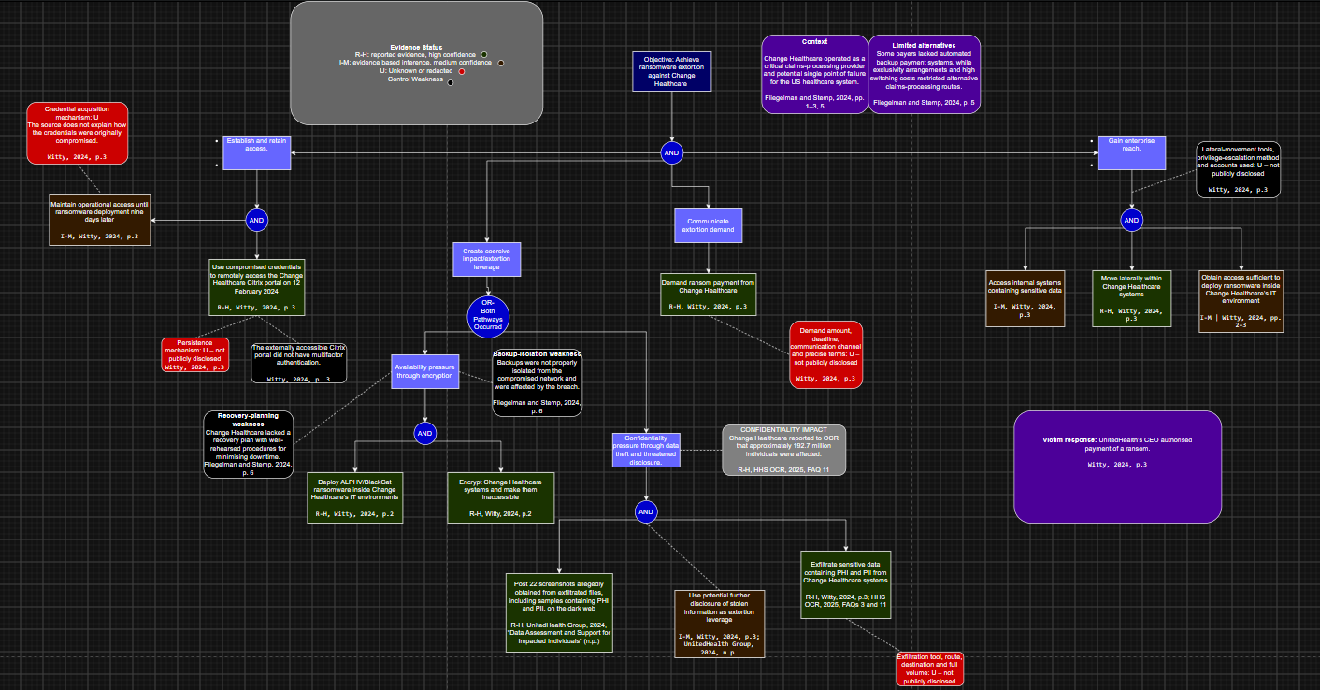
Change Healthcare Case Synthesised Attack Tree
Simplified presentation view. Full model provided in Appendix F.
Notes:
The technical compromise affected Change Healthcare directly, but disruption to its claims and payment services spread the impact across the healthcare sector. This means the attack pathway explains how the compromise occurred, while service concentration helps explain why the consequences became so widespread.
(Fliegelman and Stemp, 2024, pp. 2–6)

Slide 15
Change Healthcare Case-Synthesised Attack Tree Analysis
Key Interpretation
The root uses AND because the attacker required access, enterprise expansion, coercive impact and communication of the demand.
Initial access as strong evidence: attackers used compromised credentials to enter the Citrix Portal.
The method used to obtain those credentials remains unknown.
Encryption and stolen data form OR branches because either could create extortion pressure. Both occurred in this incident.
Confirmed control weakness
The Citrix portal did not require multifactor authentication
Remaining evidence gaps
Credential acquisition method: U
Persistence mechanism: U
Privilege escalation and lateral-movement methods: U
Detailed data-exfiltration route: U
Key finding: Public evidence clearly establishes the initial entry and resulting impact, but provides limited details about the attacker’s activity between those stages
Sources: Synthesis based on Witty (2024, pp. 2–3), Fliegelman and Stemp (2024, pp. 1–6) and UnitedHealth Group (2024). Full model in Appendix F.
Notes:
[Talk key finding]
Public evidence clearly establishes the initial entry and resulting impact, but provides limited details about the attacker’s activity between those stages.

Slide 16
Cross Incident Comparison
Attack Dimension | HSE, 2021 | Change Healthcare, 2024 | Cross incident conclusion
Initial access | Malicious Excel attachment delivered through phishing | Compromised credentials used to access a Citrix portal without MFA | Ransomware can begin through different entry routes, represented as OR alternatives
Enterprise expansion | AD reconnaissance, privileged accounts, trusted connections and vulnerability exploitation | Lateral movement and data theft reported, but detailed methods remain undisclosed | Enterprise access depends on identity, privilege and network reach
Coercive impact | Conti encryption combined with theft and publication of data | Ransomware combined with theft of personal and health information | Both incidents used availability and confidentiality pressure
Business exposure | Disruption across the national health service and connected hospitals | Disruption to claims, payments and pharmacy transactions across the healthcare sector | Healthcare dependencies increased the scale of downstream disruption
Evidence gaps | Persistence, hospital exploit and exfiltration mechanisms remain partly unknown or redacted | Credential acquisition and most post-access techniques remain unknown | The final model must distinguish reported actions from assumptions and competing hypothesis
Cross incident finding: Different initial access routes converged after entry. Both attackers expanded beyond the initial foothold and created extortion pressure through operational disruption and stolen data.
Sources: PwC (2021, pp. 29, 45, 47–55); Witty (2024, pp. 2–3); Fliegelman and Stemp (2024, pp. 1–6); UnitedHealth Group (2024).
Notes:
The main difference was initial access:
a malicious attachment at HSE, compared with compromised remote-access credentials at Change Healthcare.
After entry, the pattern converged.
Both attackers expanded beyond the first system, moved laterally, stole sensitive information, and deployed ransomware.
Both used availability and confidentiality pressure to support extortion.
Recurring risk areas therefore include identity protection, detection, privileged access, segmentation, and recovery.
The evidence does not prove that every weakness existed equally in both organisations, so that limitation remains visible in the final model.
(PwC, 2021, pp. 29, 45–55; Witty, 2024, pp. 2–4; Fliegelman and Stemp, 2024, pp. 2–6)

Slide 17
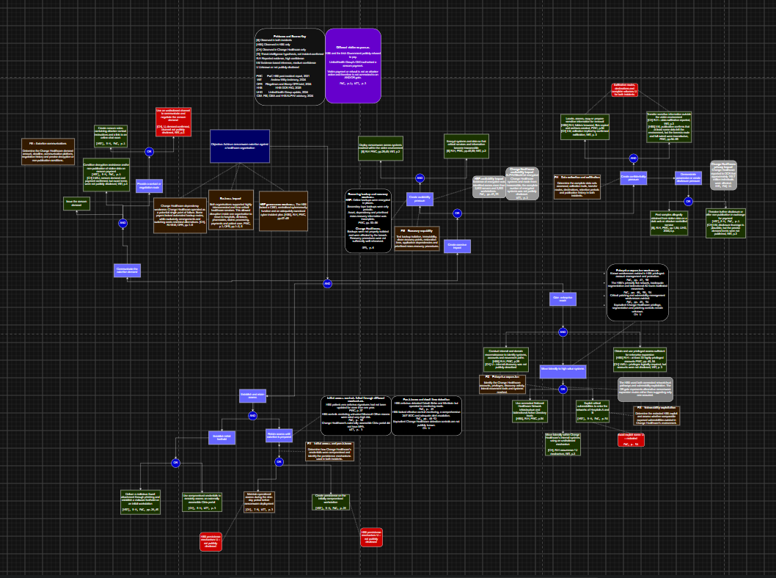
Final Synthesised Healthcare Ransomware Attack Tree
How to read the model
1. The root uses AND because extortion requires access, enterprise expansion, coersive impact and communication of a demand
2. Initial access uses OR branches to represent the different entry routes identified across the incidents
3. Enterprise expansion captures the common need to move beyond the initial foothold
4. Encryption and stolen data pressure form OR branches. Attackers may use either method or combine both
Evidence boundary
The model distinguishes reported evidence, evidence based inference and unknown mechanisms. It represents two incidents and remain preliminary.
Main conclusion
Different entry routes converged on the same downstream objective. Controls that prevent enterprise expansion can disrupt several ransomware pathways before attackers create extortion pressure.
Initial cross-incident model based on HSE and Change Healthcare. Full-size model provided in Appendix G.
Sources: Synthesis based on PwC (2021, pp. 29, 37, 45, 47–55); Witty (2024, pp. 2–3); Fliegelman and Stemp (2024, pp. 1–6); UnitedHealth Group (2024); CISA et al. (2024).
Notes:
The final tree models healthcare ransomware extortion, rather than replaying either incident.
The root uses an AND gate because successful extortion requires access, expansion, coercive impact, and communication of a demand.
Initial access has two evidenced alternatives.
One involves malicious-document delivery, as seen at HSE.
The other uses compromised credentials against remote access, as seen at Change Healthcare.
The original source of the Change credentials remains unknown.
Expansion includes discovery, privileged access, and lateral movement through trusted relationships or exploitable vulnerabilities.
Coercive impact can come from encryption or stolen-data pressure.
The OR gate represents alternative sources of leverage, while the annotation records that both occurred in these incidents.
The evidence colours show which branches are reported, inferred, or unknown.
This keeps the model useful without presenting assumptions as facts.
(PwC, 2021, pp. 29, 45–55; Witty, 2024, pp. 2–4; UnitedHealth Group, 2024)

Slide 18
Priority Risks and Recommendations
ID | Risk identified from the final tree | Priority | Recommended action
FI1 | Phishing or compromised credentials provide initial access | Critical | Require phishing-resistant MFA for remote access, restrict untrusted macros and strengthen email filtering
FI2 | Attackers maintain access without effective detection | Critical | Operate endpoint protection in blocking mode, centralise security logs and provide continuous monitoring with tested alert escalation
FI3 | Compromised privileged accounts enable enterprise control | Critical | Implement privileged access management, separate administrator accounts, enforce admin MFA and apply least privilege
FI4 | Flat or trusted networks enable lateral movement | High | Segment critical environments, restrict unnecessary AD trusts and monitor traffic between network zones
FI5 | Encryption disrupts critical services and delays recovery | Critical | Maintain unalterable and offline backups, map critical dependencies and regularly test service-scale restoration
FI6 | Stolen sensitive data creates additional extortion pressure | High | Inventory sensitive data, restrict bulk access, monitor unusual data transfers and rehearse breach response procedures
Immediate priorities: Strong identity controls, active security monitoring, protected privileged accounts and recoverable backups interrupt the greatest number of pathways
Recommendations assume a large, interconnected healthcare organisation handling critical services and sensitive health information. Not every weakness has been confirmed in both incidents.
Sources: PwC (2021, pp. 47–56); Witty (2024, pp. 2–3); CISA et al. (2024); Australian Signals Directorate (2023); Mahn et al. (2021)
Notes:
The highest priorities concern initial access, attacker expansion, and recoverability.
Healthcare organisations should enforce phishing-resistant MFA for remote and privileged access, block untrusted Office macros, and maintain endpoint protection.
They should operate endpoint detection in prevention mode,
centralise security logs, and establish continuous alert monitoring with clear escalation procedures.
Privileged-access management and network segmentation can prevent one compromised device from becoming an enterprise-wide incident. Critical vulnerabilities also require accurate asset inventories,
continuous scanning, and risk-based patching deadlines.
To reduce double-extortion risk, organisations should monitor unusual outbound transfers and bulk encryption.
Recovery requires immutable or offline backups, separate backup credentials, and regularly tested restoration.
Finally, critical services and technology dependencies should be mapped, so recovery priorities and manual alternatives are understood before an incident.
These controls align with the NIST functions of Identify, Protect, Detect, Respond, and Recover.
(Mahn et al., 2021, pp. 1–3; CISA, FBI and HHS, 2024, pp. 8–9; PwC, 2021, pp. 47–55; Fliegelman and Stemp, 2024, pp. 5–6)

Slide 19
Priority Areas for Further Investigation
Priority | Investigation question | Why it matters | Evidence required
1 | How did the attackers obtain the Change Healthcare credentials? U | Confirms the initial-access pathway and the controls that failed | Identity-provider and Citrix logs, phishing reports and credential-exposure records
2 | How did the attackers maintain access and avoid detection? U / I-M | Establishes whether monitoring or escalation failures extended the dwell time | Endpoint telemetry, SIEM alerts, host images and incident tickets
3 | Which accounts, trusts or vulnerabilities enabled enterprise expansion? R-H / U | Identifies the main opportunities to stop privilege abuse and lateral movement | AD and privileged-access records, trust maps, vulnerability data and network logs
4 | How and when did data exfiltration occur? I-M / U | Determines breach scope, notification duties and confidentiality risk | Firewall, proxy, DNS and cloud logs, file-access records and data-loss alerts
5 | Could critical services and backups recover independently at scale? I-M | Tests whether recovery arrangements match healthcare service dependencies | Asset registers, dependency maps, backup configurations and restoration-test results
Next research stage: Analyse additional healthcare ransomware incidents to determine which branches represent recurring patterns and which remain specific to HSE or Change Healthcare
Investigation priorities derived from evidence gaps in PwC (2021, pp. 29, 47–56); Witty (2024, pp. 2–3); Fliegelman and Stemp (2024, pp. 1–6); UnitedHealth Group (2024).
Notes:
The next stage should determine how the Change Healthcare credentials were obtained, and identify the undisclosed HSE persistence method. It should also examine Change Healthcare’s privilege escalation and lateral movement, the alerts available during both periods, and the exact data exfiltration routes.
Finally, backup isolation, recovery objectives, and critical-provider dependencies require further testing.
These answers may change the tree’s branches, evidence confidence, and control priorities.
The model should therefore be treated as preliminary
(PwC, 2021, pp. 29, 54–55; Witty, 2024, p. 3; Fliegelman and Stemp, 2024, pp. 5–6)

Slide 20
Executive Conclusion
Different initial-access routes produced the same result once attackers gained enterprise reach: critical service disruption combined with stolen data pressure.
1. Main finding
HSE was breached through a malicious attachment, while Change Healthcare was breached using compromised remote access credentials. These incidents then expanded within the enterprises, leading to ransomware deployment and data theft
2. Executive priority
Organisations should place importance on controls that prevent a local foothold from becoming an enterprise compromise:
- Strong remote access and privileged-account authentication
- Active endpoint monitoring and alert escalation
- Network segmentation and restricted trust relationships
- Unalterable backups and tested restoration of critical services
3. Limitation and next step
The model draws from two publicly reported incidents. Redactions and incomplete disclosures leave several persistence, lateral-movement and exfiltration mechanisms unresolved. Additional cases should test and refine these branches.
Executive decision: Direct early investment toward identity security, detection, containment and verified recovery because these controls interrupt several attack pathways.
Conclusions based on PwC (2021); Witty (2024); Fliegelman and Stemp (2024); UnitedHealth Group (2024); CISA et al. (2024).
Notes:
The central finding is straightforward.
Healthcare ransomware can enter through different doors,
but successful attacks often converge on the same problem:
attackers gain enough time and privilege to expand before containment.
HSE demonstrates the effect of long dwell time and broad network reach.
Change Healthcare demonstrates how a control gap at a highly connected provider can transmit disruption across a sector.
The response should therefore
protect access,
detect expansion early,
limit lateral movement,
and maintain recovery systems that attackers cannot reach.
(PwC, 2021; Witty, 2024; Fliegelman and Stemp, 2024)

Slide 21
References Incident Evidence
PricewaterhouseCoopers (PwC) 2021, Conti cyber attack on the HSE: Independent post incident review, Health Service Executive, 3 December, viewed 20 August 2026,
https://about.hse.ie/api/v2/download-file/file_based_publications/conti_cyber_attack_on_the_hse_full_report.pdf/
Witty, A. 2024, ‘Hacking America’s health care: assessing the Change Healthcare cyber attack and what’s next’, testimony before the United States Senate Committee on Finance, 1 May, viewed 25 August 2026, https://www.finance.senate.gov/imo/media/doc/hacking_americas_health_care_assessing_the_change_healthcare_cyber_attack_and_whats_next.pdf
Fliegelman, A. and Stemp, D. 2024, The cyberattack on Change Healthcare: lessons for financial stability, OFR Brief no. 24-05, Office of Financial Research, 13 November, viewed 25 August 2026, https://www.financialresearch.gov/briefs/files/OFRBrief-24-05-change-healthcare-cyberattack.pdf
UnitedHealth Group 2024, ‘UnitedHealth Group updates on Change Healthcare cyberattack’, 22 April, viewed 25 August 2026,
https://www.unitedhealthgroup.com/newsroom/2024/2024-04-22-uhg-updates-on-change-healthcare-cyberattack.html
U.S. Department of Health and Human Services, Office for Civil Rights 2025, ‘Change Healthcare cybersecurity incident frequently asked questions’, updated 14 March, viewed 25 August 2026
https://www.hhs.gov/hipaa/for-professionals/special-topics/change-healthcare-cybersecurity-incident-frequently-asked-questions/index.html
Mahn, A., Marron, J., Quinn, S. and Topper, D. (2021) Getting Started with the NIST Cybersecurity Framework: A Quick Start Guide. NIST Special Publication 1271. Gaithersburg, MD: National Institute of Standards and Technology. Available at: https://doi.org/10.6028/NIST.SP.1271 (Accessed: 8 September 2026).
Software reference
JGraph Ltd 2026, draw.io [diagramming software], viewed 20 August 2026, https://www.drawio.com/.
OpenAI 2026a, ChatGPT response to a prompt requesting an attack tree for the 2021 HSE Conti ransomware incident, large language model output, 26 August, OpenAI, https://chatgpt.com/. Prompt and output reproduced in Appendix B.
OpenAI 2026b, ChatGPT Astra response to a prompt requesting an attack tree for the 2024 Change Healthcare ransomware incident, large language model output, 26 August, OpenAI, https://chatgpt.com/. Prompt and output reproduced in Appendix E.
Notes:
The complete Harvard references and supporting attack-tree models are provided in the reference and appendix slides.
Thank you.

Slide 22
References Framework, Guidance, and Tools
Frameworks and guidance
Australian Signals Directorate 2023, Essential Eight maturity model, Australian Cyber Security Centre, updated 27 November, viewed 23 August 2026, https://www.cyber.gov.au/business-government/asds-cyber-security-frameworks/essential-eight/essential-eight-maturity-model.
Cybersecurity and Infrastructure Security Agency, Federal Bureau of Investigation and U.S. Department of Health and Human Services 2024, #StopRansomware: ALPHV Blackcat, Cybersecurity Advisory AA23-353A, revised 27 February, viewed 24 August 2026, https://www.cisa.gov/news-events/cybersecurity-advisories/aa23-353a.
Mahn, A., Marron, J., Quinn, S. and Topper, D. 2021, Getting started with the NIST Cybersecurity Framework: a quick start guide, NIST Special Publication 1271, National Institute of Standards and Technology, viewed 24 August 2026, https://doi.org/10.6028/NIST.SP.1271.
Schneier, B. 1999, ‘Attack trees’, Dr. Dobb’s Journal, vol. 24, no. 12, pp. 21–29, viewed 21 August 2026 https://www.schneier.com/academic/archives/1999/12/attack_trees.html

Slide 23
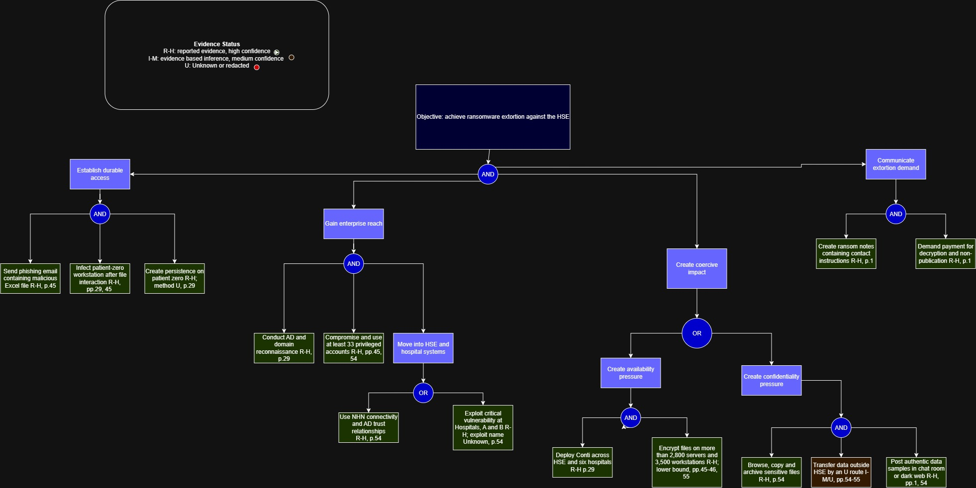
Appendix A: HSE Manual Attack Tree
https://drive.google.com/file/d/1iaB1qmiFjICW4IeoZkhvZikyxo0mil3d/view?usp=sharing

Slide 24
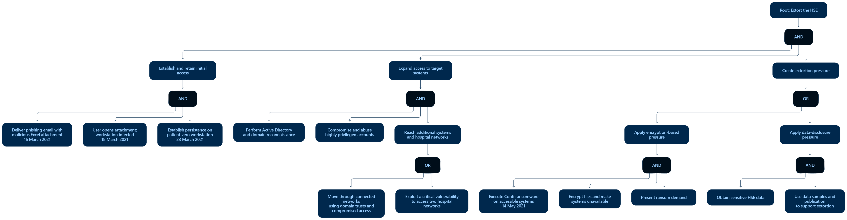
Appendix B: HSE LLM Output
Appendix B1: Prompt
Tool: ChatGPT
Provider: OpenAI
Date generated: 26 August 2026
Approach: Single prompt and response
Input: PwC HSE post-incident report
“Based on the attached PwC report, create an attack tree for the 2021 Conti ransomware attack on the HSE. Show the root objective and use AND/OR branches.”
Appendix B2: HSE LLM Response
https://drive.google.com/file/d/1CvcQLo2KiDT-reJvvr1AotKRfT42epE3/view?usp=sharing

Slide 25
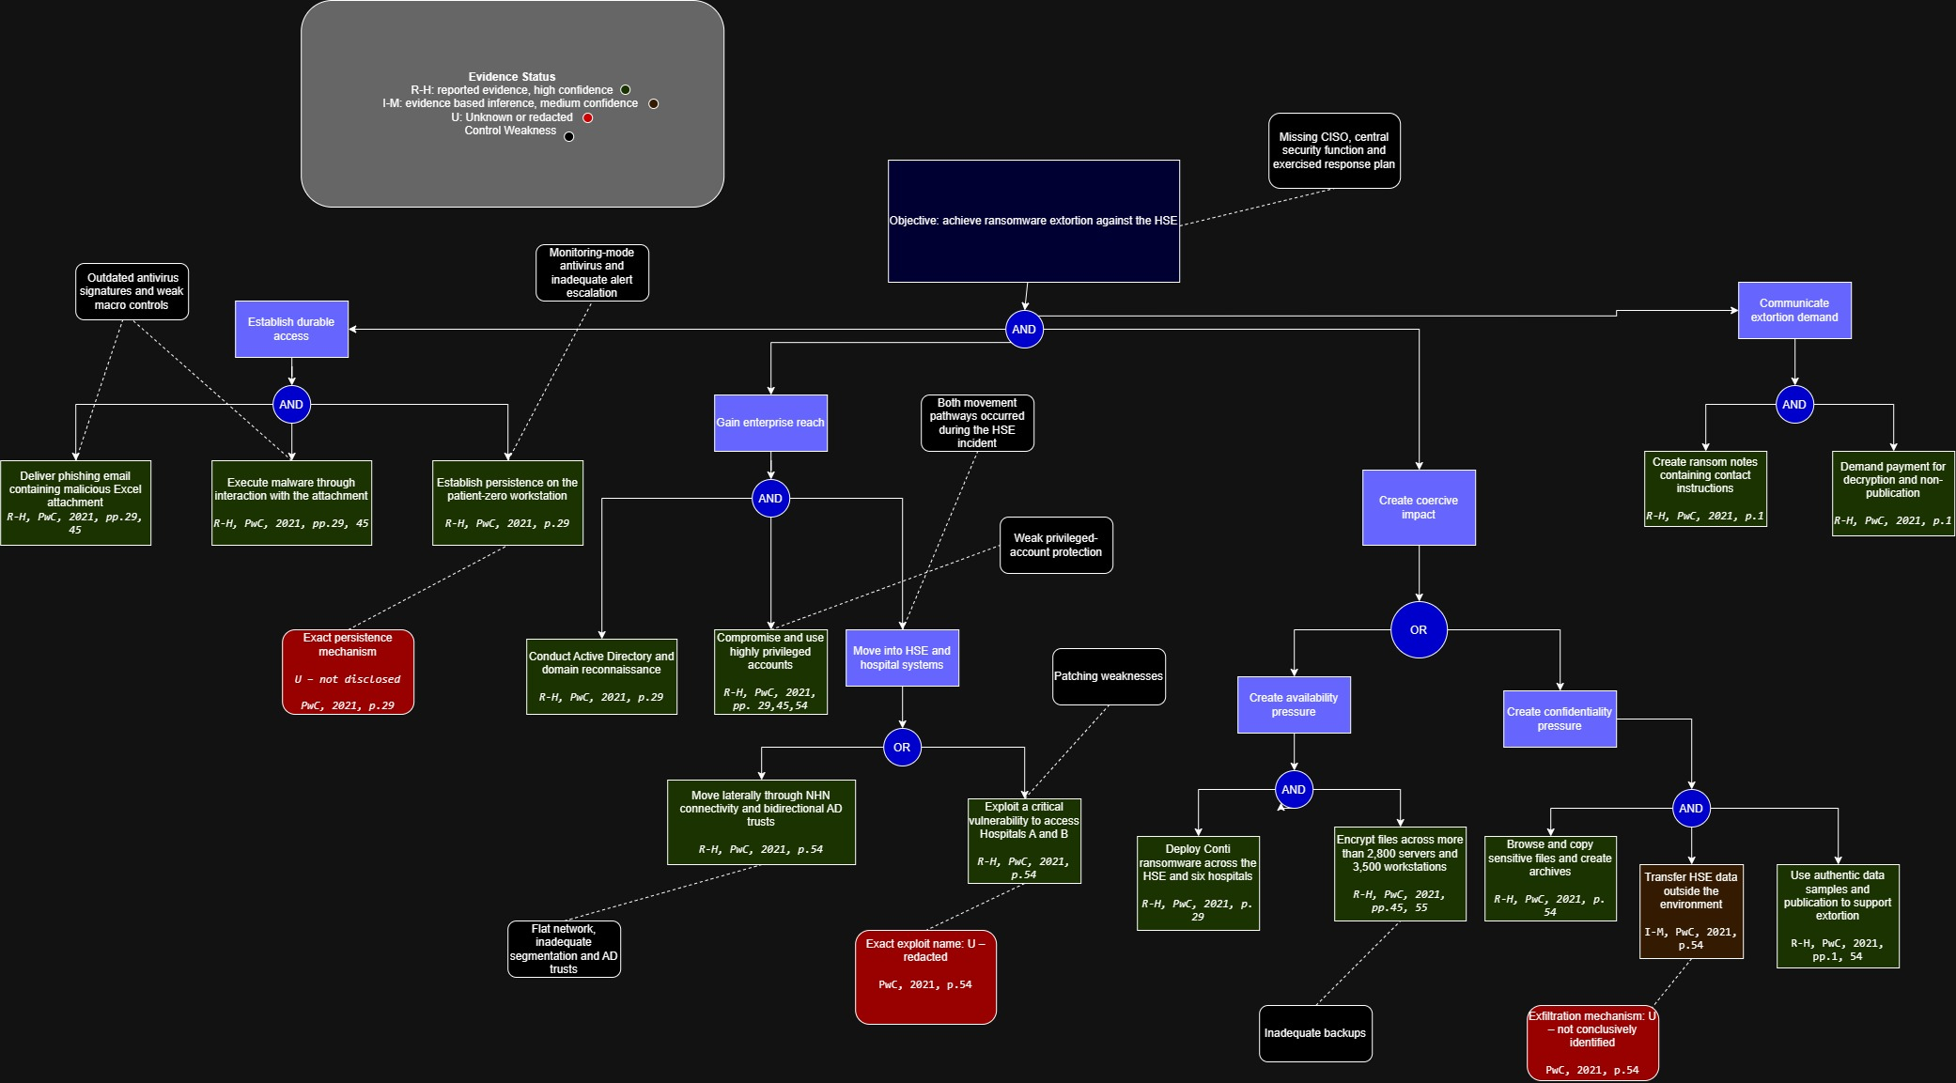
Appendix C: HSE Case Synthesis
https://drive.google.com/file/d/1875WoYf3Tro06S6QO6Fxyfqzw98t4qC6/view?usp=sharing

Slide 26
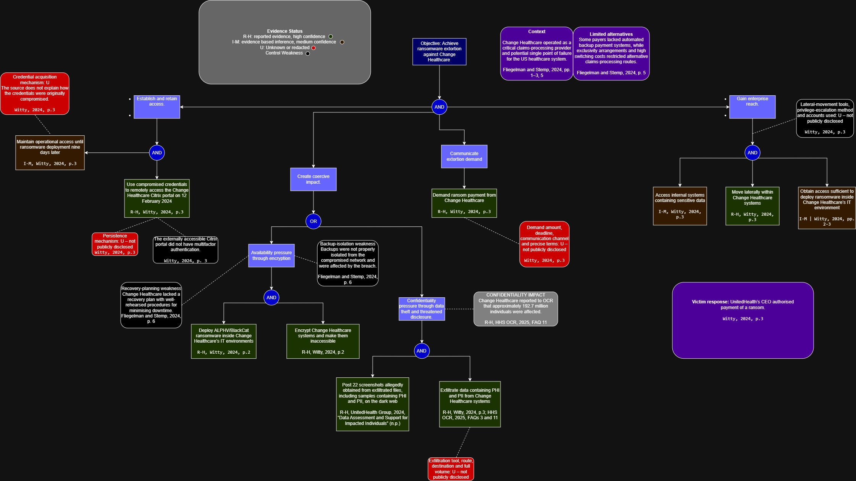
Appendix D: Change Healthcare Manual Tree
https://drive.google.com/file/d/1aXDwO1SbzQEUkJPJ0-nw1iWgNPFZEdS6/view?usp=sharing

Slide 27
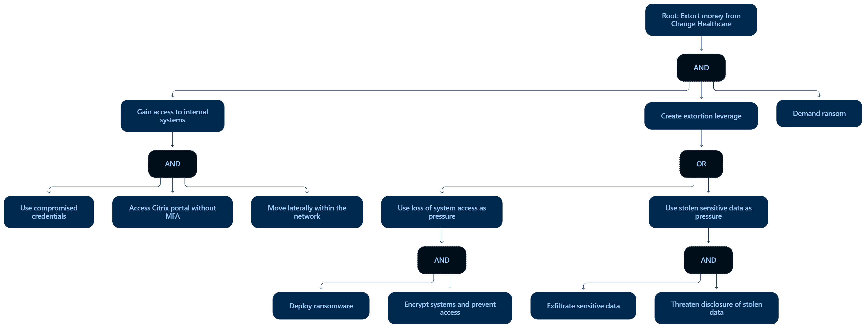
Appendix E: Change Healthcare LLM Output
Appendix E1: Prompt
Tool: ChatGPT
Provider: OpenAI
Date generated: 26 September 2026
Approach: Single prompt and response
Prompt used:
“Create an attack tree for the Change Healthcare, United States (2024) attack. Show the root objective and use AND/OR branches.”
Appendix E3: Change Healthcare LLM response
https://drive.google.com/file/d/1QLfK1tXubo2P9SCv_tKxIS2CBG5WJXOY/view?usp=drive_link

Slide 28
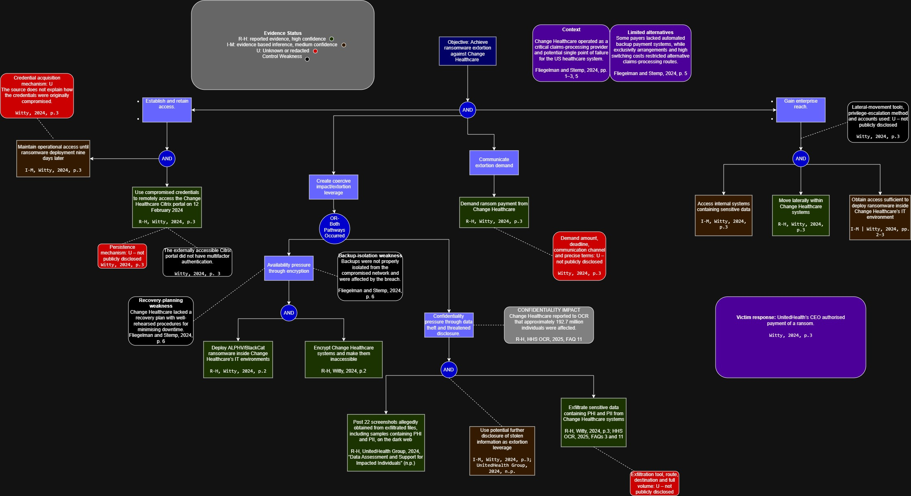
Appendix F: Change Healthcare Case Synthesised Attack Tree
https://drive.google.com/file/d/1Uv3Xc6BV9VGHMZ_LIEB1tR5tuOBkDhXa/view?usp=sharing

Slide 29
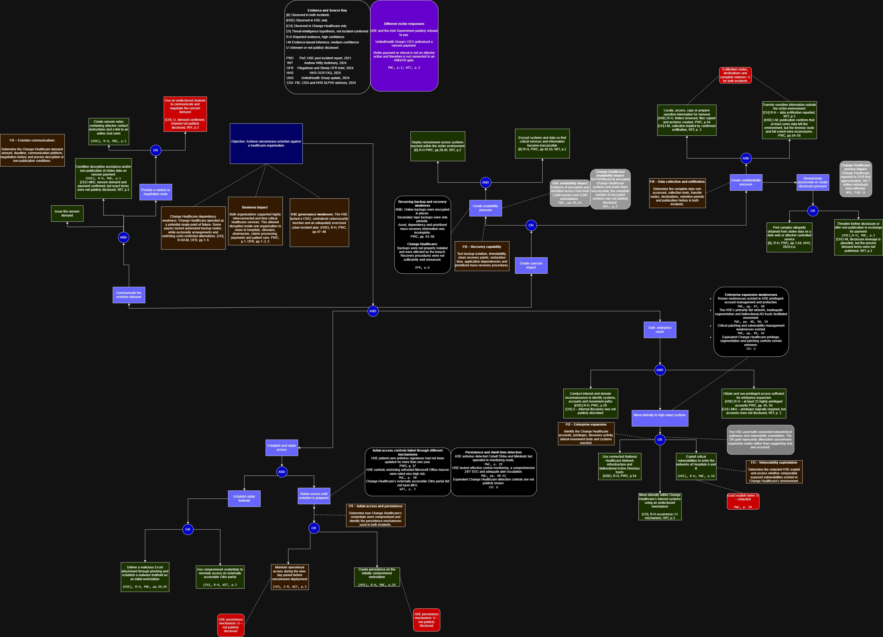
Appendix G: Final Synthesised Tree
https://drive.google.com/file/d/17Wx9up6d5auY9A5wpFIFoIOaSzseZXvO/view?usp=sharing

